Slide 1
TRAFFIC TELLIGENCE: ADVANCED TRAFFIC VOLUME ESTIMATION WITH MACHINE LEARNING
BATCH MEMBERS:
JAYASRI B[513320106016]
ARUNA A[513320106003]
GAJALAKSHMI S[513320106011]
JAIPRIYA s[513320106015]
UNDER THE GUIDANCE OF :
Mrs.Meenapriya m.e., (pH.d).,
Teaching fellow/UCEA.

Slide 2
PRESENTATION OUTLINE:
INTRODUCTION
ABSTRACT
OBJECTIVE
SOLUTION ARCHITECTURE
BLOCK DIAGRAM
ALGORITHMS
PREDICTION
ADVANTAGES
DISADVANTAGES
FUTURE SCOPE
CONCLUSION
REFERENCES

Slide 3
INTRODUCTION
Traffic problem is one of the major problem now a days, In the increase in no of vehicles and non –usage of public transport leading to traffic related issues.
To address such problems to tracking the vehicle count in each and every place AI-ML has given a solution to such kind of traffic related issues, which are able to measure the volume of traffic, identify the violations of traffic rules etc.
Advanced traffic volume estimation with machine learning is to predict traffic volumes with high accuracy, efficiency, and reliability.

Slide 4
ABSTRACT
Traffic Telligence is an advanced traffic volume estimation project that utilizes machine learning techniques to predict traffic volumes in different areas.
The project aims to provide accurate traffic volume estimates, which can be used to improve traffic management and reduce congestion on roads. The Traffic Telligence project involves collecting traffic data from various sources, such as traffic cameras, sensors, and mobile devices.
This data is then preprocessed to extract relevant features, such as traffic volume, speed, and vehicle type.

Slide 5
OBJECTIVE
Developing machine learning algorithms that can accurately predict traffic volume in real-time, using data from various sources. Incorporating real-time data, such as weather conditions or special events, to improve the accuracy of TVE. Improving the efficiency of TVE, by reducing the need for manual traffic counts or other traditional methods.

Slide 6
MACHINE LEARNING
Machine learning techniques can be broadly categorized into three types:
Supervised learning
Unsupervised learning
Reinforcement learning.
Supervised learning is the most commonly used approach for traffic volume estimation.
It involves training models on labeled data, where the input features are associated with known traffic volume outputs.
The trained models can then make predictions on new data to estimate traffic volume.

Slide 7
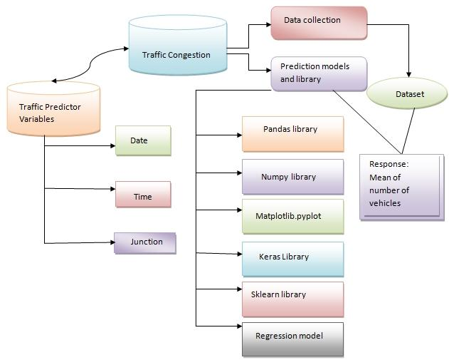
BLOCK DIAGRAM

Slide 8
ALGORITHM
Linear Regression: Linear regression is a simple and interpretable algorithm that models the relationship between input features and the traffic volume using a linear equation. Random Forest Regression: Random Forest is an ensemble algorithm that combines multiple decision trees. Gradient Boosting Regression: Gradient Boosting is another ensemble method that combines multiple weak predictive models (typically decision trees) to create a strong predictive model. Support Vector Regression: Support Vector Regression (SVR) is a variant of Support Vector Machines (SVM) adapted for regression tasks.

Slide 9
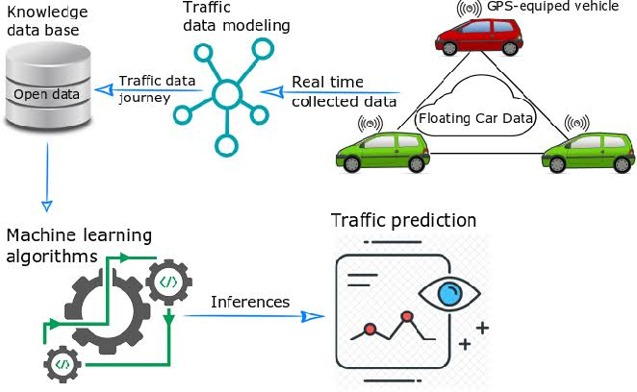
SOLUTION ARCHITECTURE

Slide 10
PROPOSED SOLUTION
Data collection: Gather historical traffic data, including features such as date, time, weather conditions, road type, location, and any other relevant variables. Data preprocessing: Clean the collected data by removing any outliers, missing values, or inconsistencies. Model selection: Choose an appropriate machine learning algorithm for your prediction task. Common algorithms for traffic volume prediction include regression models (e.g., linear regression, random forest regression, gradient boosting). Model training: Train the selected model using the training dataset. The model learns the patterns and relationships in the data to make accurate predictions. Model evaluation: Evaluate the trained model using the testing dataset. Measure its performance using metrics such as mean absolute error (MAE), mean squared error (MSE), or root mean squared error (RMSE). Deployment and prediction: Once satisfied with the model’s performance, deploy it to predict traffic volume in real-time.

Slide 11
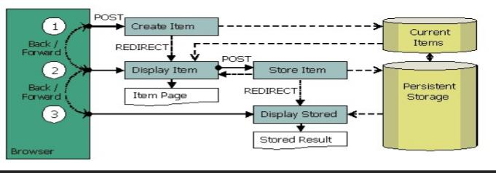
DATA FLOW DIAGRAM

Slide 12
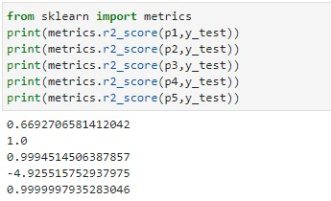

PREDICTION

Slide 13
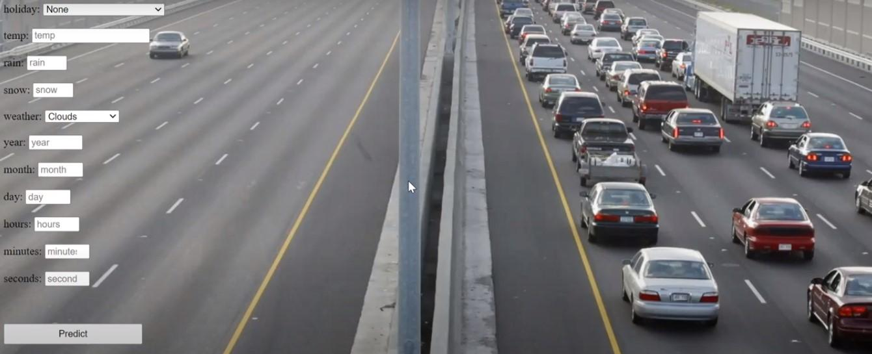
RESULT

Slide 14
ADVANTAGES
Accurate Traffic Volume Estimation Real-Time and Future Predictions
Efficient Decision-Making Improved Traffic Planning and Infrastructure Design Integration with Existing Systems Scalability and Adaptability

Slide 15
DISADVANTAGES
Data dependency Model complexity and interpretability
Computational resource requirements Privacy and security concerns Cost-Effective

Slide 16
FUTURE SCOPE
Advancements in data collection systems will provide high-quality and real-time traffic data, enhancing the accuracy of volume estimation model.
Machine learning can play a crucial role in intelligent urban traffic management, optimizing traffic signal timings and dynamically adjusting lane configurations.
Machine learning can contribute to smart city initiatives by optimizing resource allocation and enhancing urban mobility.

Slide 17
CONCLUSION
Advanced traffic volume estimation using machine learning is a promising approach to accurately predict traffic volume on roads.
By utilizing various data sources such as traffic cameras, sensors, and mobile devices, machine learning models can learn from historical data and provide accurate predictions for future traffic volume.
Overall, the use of machine learning in traffic volume estimation has the potential to significantly improve traffic management systems and ultimately lead to a more efficient and safer transportation network.

Slide 18
REFERENCES
Li, X., Ouyang, Y., & Li, Z. (2019). Traffic volume estimation from video using deep learning: A review. IEEE Transactions on Intelligent Transportation Systems, 21(12), 5228-5247. Wang, C., Wang, Y., & Zhang, L. (2019). Traffic volume prediction with spatial-temporal dependencies and weather impacts using deep learning. Transportation Research Part C: Emerging Technologies, 99, 1-17. Wu, X., Zhu, Q., & Xie, X. (2020). A deep learning model for traffic volume prediction using spatio-temporal features. Transportation Research Part C: Emerging Technologies, 120, 102780. Wang, Y., Zhang, X., Liu, Y., & Wu, J. (2020). Traffic volume prediction with deep learning: A review. IEEE Transactions on Intelligent Transportation Systems, 21(9), 3779-3795. Zhang, Y., Wang, L., & Wang, H. (2021). A hybrid deep learning model for traffic volume prediction with historical and real-time data. Transportation Research Part C: Emerging Technologies, 126, 103150.

